Slide 1
Data Mining and Knowledge Engineering
Bagging and Boosting

Slide 2
Learning Outcomes
To understand how Ensemble methods such as Bagging and Boosting can help to improve accuracy of Classification or Numeric prediction
Examine a Case Study involving the Labour data set in Weka

Slide 3
Bagging
A supervised learning approach that allows several models to have an equal vote in classification
The same mining algorithm (e.g. C4.5) creates multiple models
The models vary because different subsets of training instances (from the overall training pool) are selected and used to build each model

Slide 4
Ensemble Methods
Construct a set of classifiers from the training data
Predict class label of previously unseen records by aggregating predictions made by multiple classifiers

Slide 5
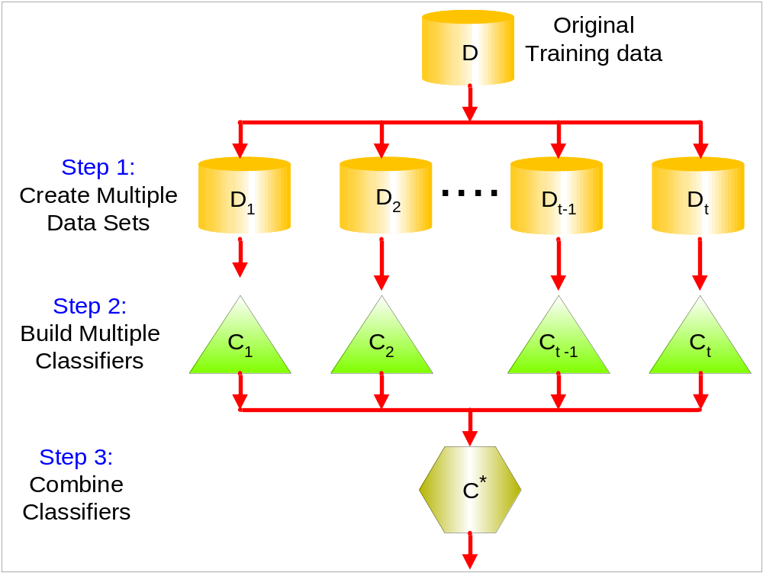
General Idea

Slide 6
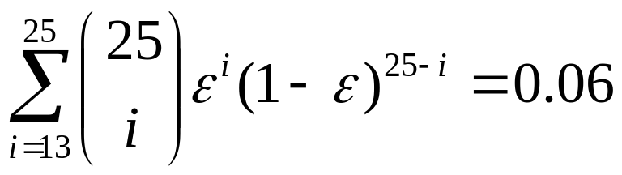
Why does it work?
Suppose there are 25 base classifiers
  Each classifier has error rate, ε = 0.35
  Assume classifiers are independent
  Probability that the ensemble classifier makes a wrong prediction:

Slide 7
Examples of Ensemble Methods
How to generate an ensemble of classifiers?
  Bagging
  Boosting

Slide 8
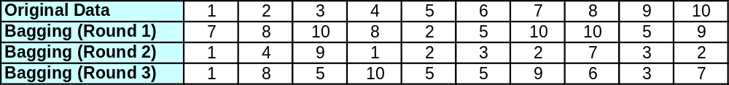
Bagging
Sampling with replacement
Build classifier on each bootstrap sample
Each sample has probability 1-(1 – 1/n)^{n} of being selected

Slide 9
Bagging - Algorithm
Randomly select several training datasets of equal size from the training pool. Instances are sampled with replacement. This allows each instance to be present in several training sets.
Apply the data mining algorithm to build a classification model for each training set. N sets of training data result in N classification models.
To classify unknown instance I, present I to each classifier. Each classifier is allowed one vote. The instance is placed in the class achieving the most votes.

Slide 10
Bagging in Weka
Bagging is supported and can be used together with any classification technique (e.g. C4.5, Naïve Bayes, K-NN, MLP, etc)
To use Bagging:
Make use of the preprocess tab to open up a data file in the usual way.
Now use the classifier tab and select the “meta” folder.
Select the “bagging” option from the drop down menu.
Right click in the Choose tab area and select the classifier algorithm of your choice (e.g. J48)
Hit the start button

Slide 11
Boosting
Boosting is similar to Bagging in that several models are used to vote. However, two main differences exist:
    Each new model is built upon the results of the previous ones. The latest model concentrates on correctly classifying those instances incorrectly classified by previous models.
    Once all models are built, each model is assigned a weight based on its performance on the training data. Thus better performing models are allowed to contribute more during the classification of new instances.

Slide 12
Boosting
An iterative procedure to adaptively change distribution of training data by focusing more on previously misclassified records
  Initially, all N records are assigned equal weights
  Unlike bagging, weights may change at the end of boosting round

Slide 13
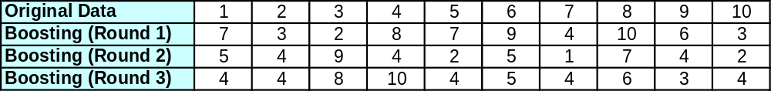
Boosting
Records that are wrongly classified will have their weights increased
Records that are classified correctly will have their weights decreased
Example 4 is hard to classify
Its weight is increased, therefore it is more likely to be chosen again in subsequent rounds

Slide 14
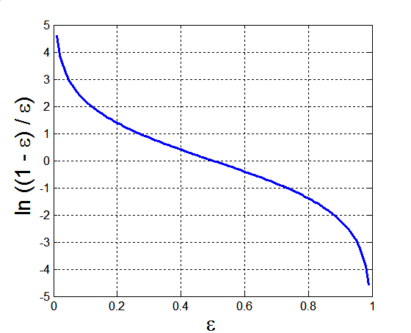
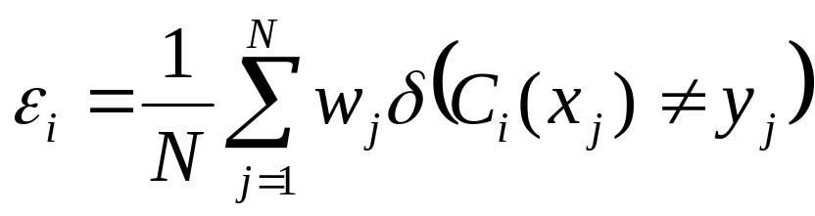
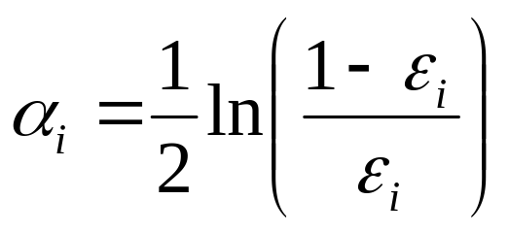
Example: AdaBoost
Base classifiers: C₁, C₂, …, C_{T}
Error rate:
Importance of a classifier:

Slide 15
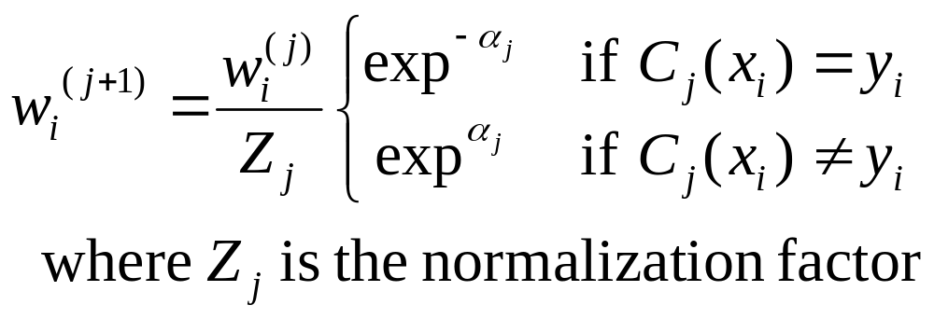
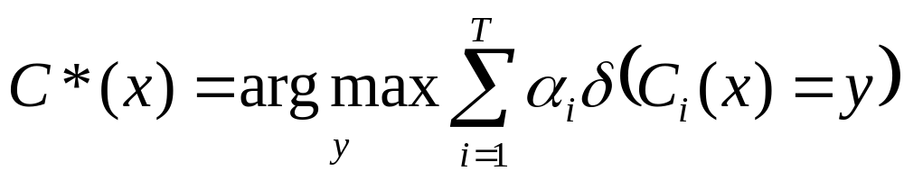
Example: AdaBoost
Weight update:
If any intermediate rounds produce error rate higher than 50%, the weights are reverted back to 1/n and the resampling procedure is repeated
Classification:

Slide 16
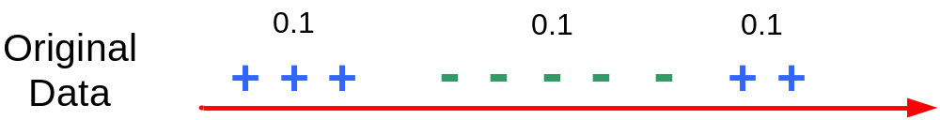
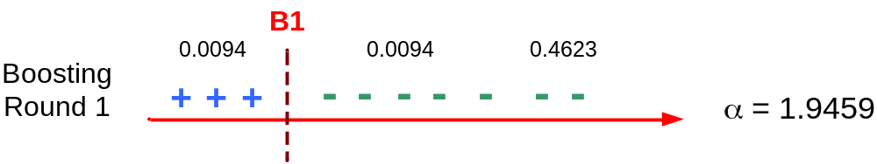
Illustrating AdaBoost
Initial weights for each data point
Data points for training

Slide 17
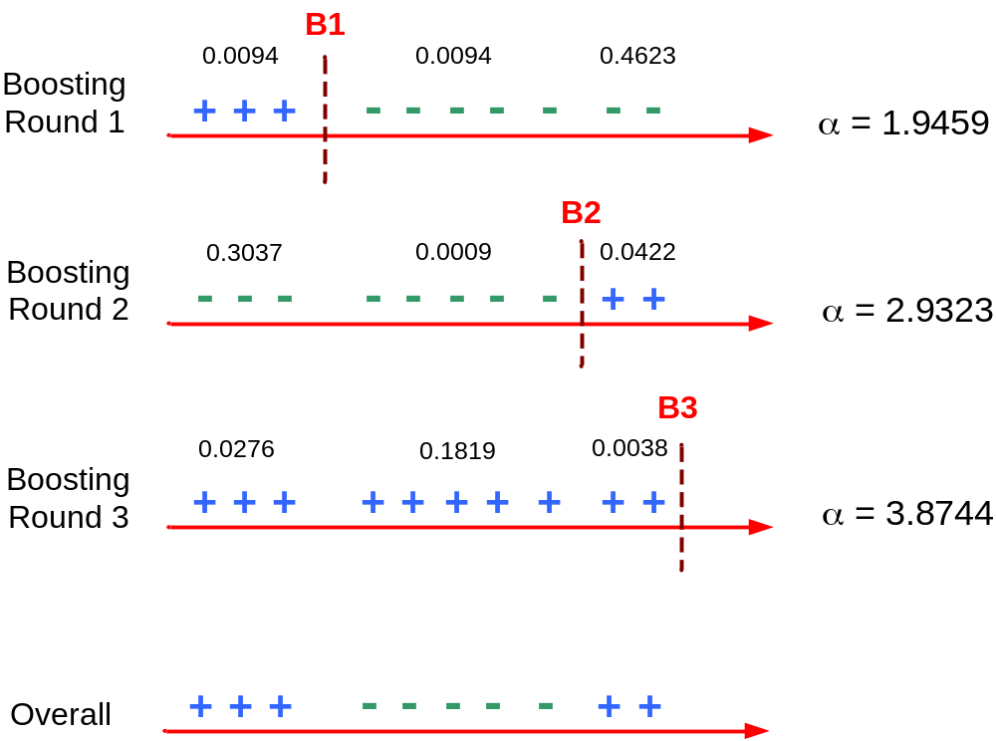
Illustrating AdaBoost

Slide 18
Boosting in Weka
Boosting is also supported and can be used together with the classifier of your choice.
The procedure for using it is identical to that of Bagging, except for step 4 where you choose “AdaBoostM1” instead of “bagging”.

